Slide 1
INTRODUCTION TO AUTOMATION
Name: Nishkarsh Raj
Class: DevOps-B2
SAP ID: 500060720
Roll Number: R171217041
Subject: Development Automation
Year of Study: II Year

Slide 2
Automation
What is automation???
Example of automation in real life???
Is the term related to computer science???
Automation in SDLC???
What to automate??
What we cannot automate??

Slide 3
What to Automate???
Cognitive???
Manual???

Slide 4
Automation In DevOps
DevOps is a set of methodologies to implement SDLC.
Main features are CI,CD
Continuous????
Automation for continuity???

Slide 5
Routine Jobs
Similar activities are repeated.
Monotonous
Example in real life???
Example in SDLC???

Slide 6
Case Study Example
Can you think about something in our daily life which is using automation since so long??
ATM: Automatic/Automated Teller Machine are being used since 1960s.

Slide 7
Important Jargons and their difference
Manual versus cognitive
Routine versus non-routine

Slide 8
How to check which tasks can be automated?
Repeat a task iteration multiple times.
Analyse which task has been done in a similar fashion all the times.
These tasks are routine tasks which can be automated.
In SDLC, Continuous Delivery and Data Centre/Cloud Automation is used along with Agile and LEAN methodologies to find tasks to be automated.

Slide 9
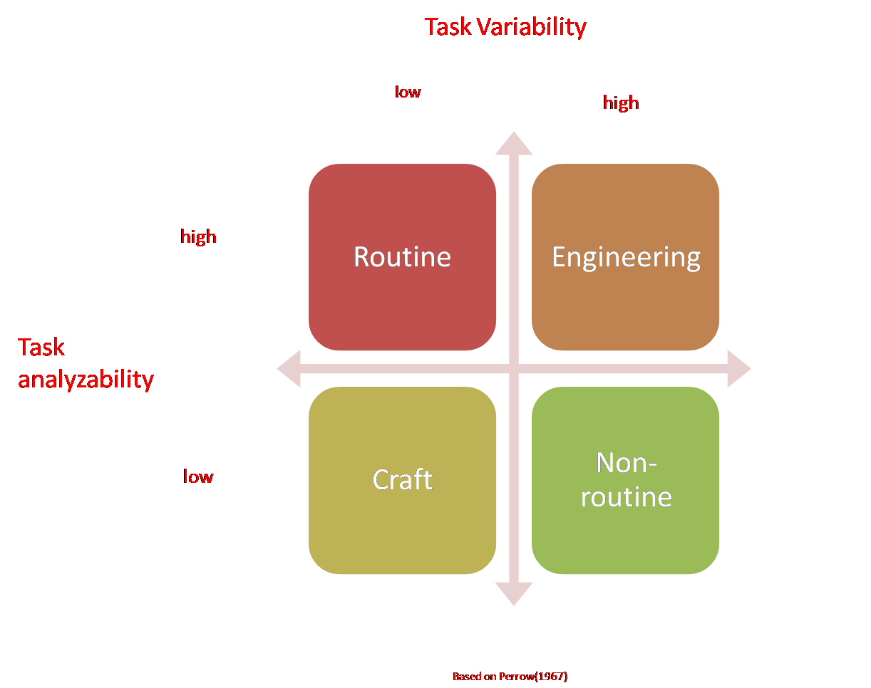
Task Classification Quadrant (Perrow)

Slide 10
Task Classification Quadrant Jargons
Task Analyzability: It is defined as the extent to which, when an exception is encountered, there are known analytical methods for dealing with it.
Task Variability: It is defined as the number of exceptions to the standard procedure encouraged in the application of given technology.

Slide 11
Best SDLC Practise
High Task Analyzability.
High Task variability??????????
No!!!!
Low Task Variabilty.
Why???

Slide 12
Examples of Routine tasks that can be automated
Manual Test execution
Manual Deployment execution
Manual Code compilation
Real life example???

Slide 13
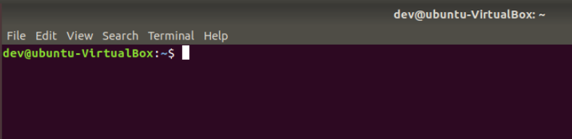
Example 1: Automation via terminal

Slide 14
What can you learn from last slide??
Which we open terminal, we are In which directory?
Shortcut to open terminal?
What is terminal?
Which process runs automatically when we open terminal?
How can we use the above process to do some automation?

Slide 15
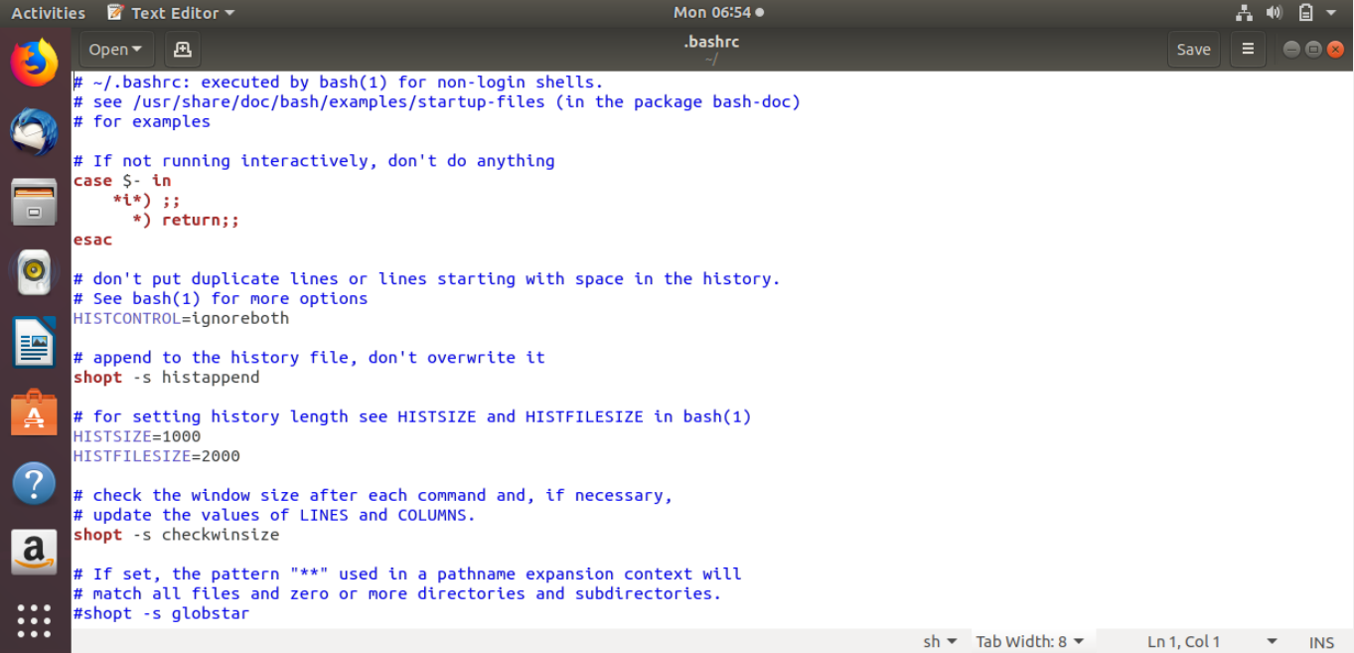

Slide 16
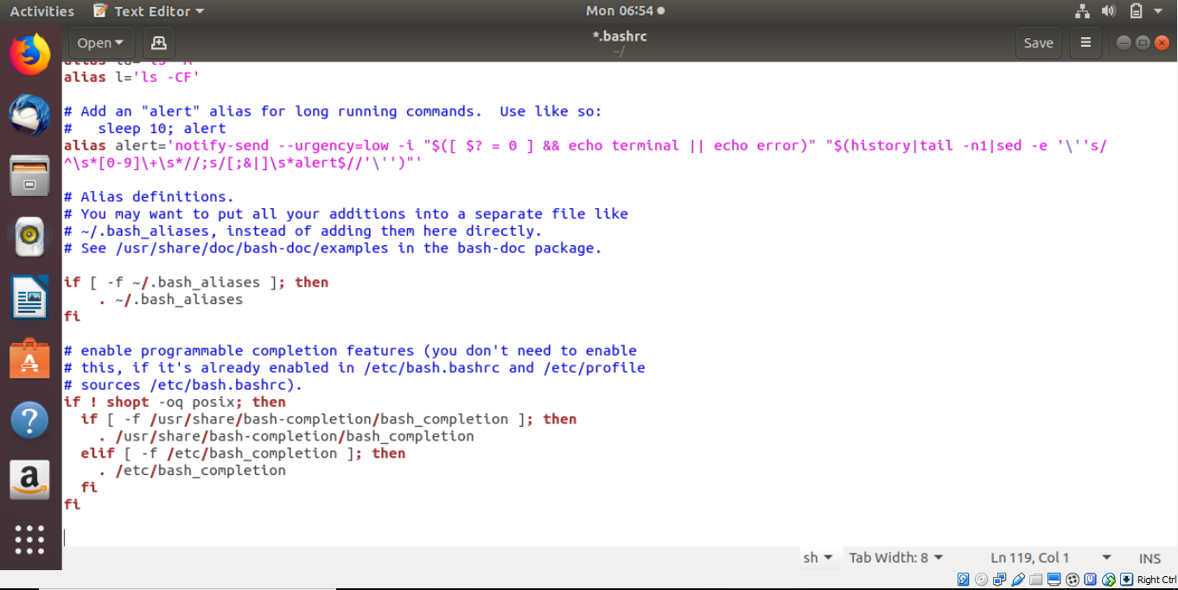

Slide 17
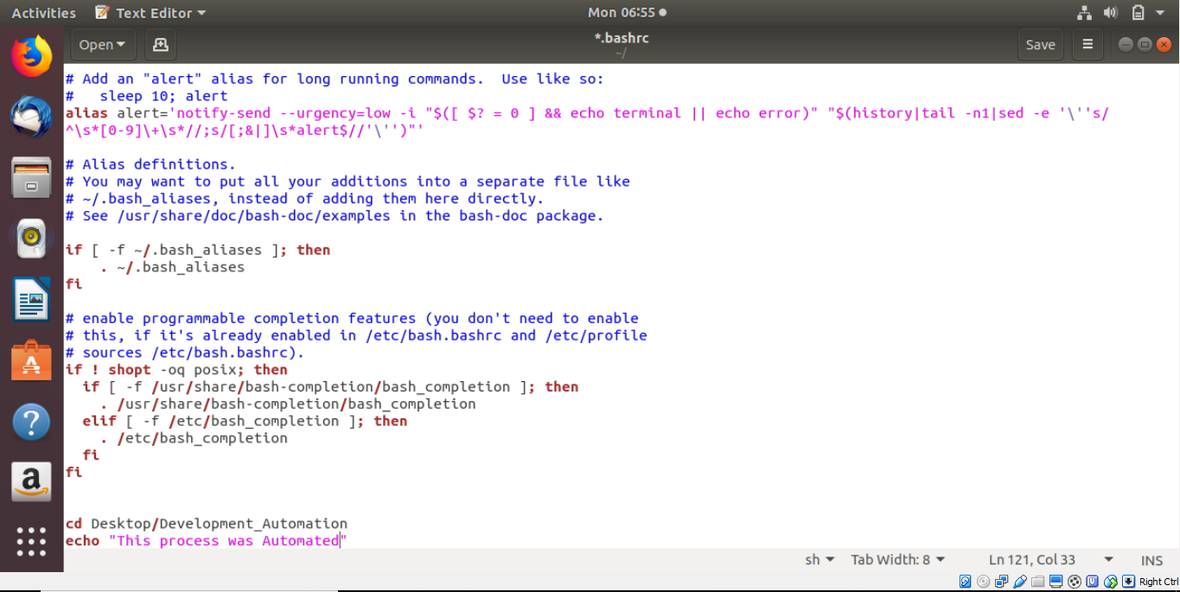

Slide 18
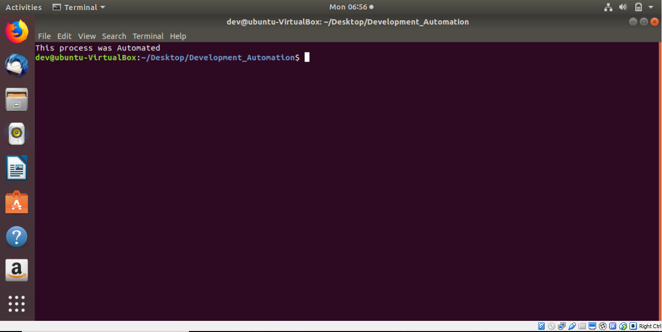

Slide 19
Problems in automating via .bashrc file
Need to open terminal to perform the task.
Alternatives that run whenever we open our system?
Scheduling techniques?
Any scheduling techniques we know??

Slide 20
Crontab
What is crontab??
Basic Syntax of crontab??
Disadvantage of crontab??
Where is crontab stored?

Slide 21
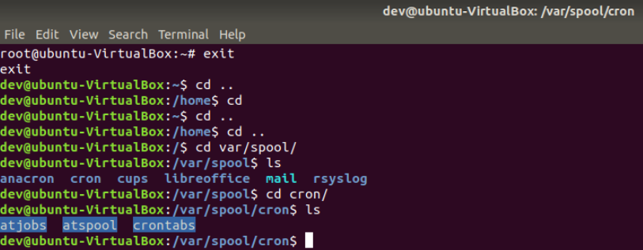

Slide 22
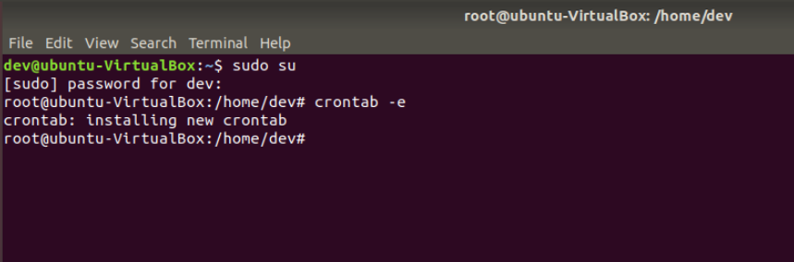

Slide 23
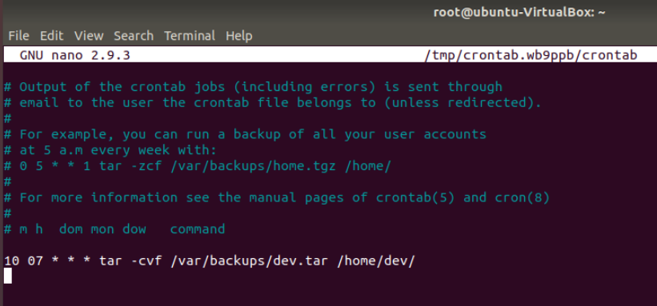

Slide 24
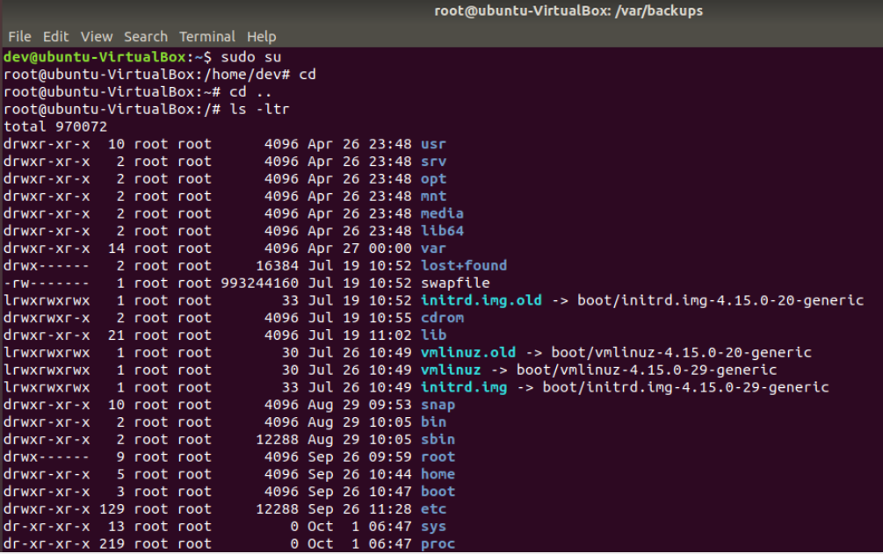

Slide 25
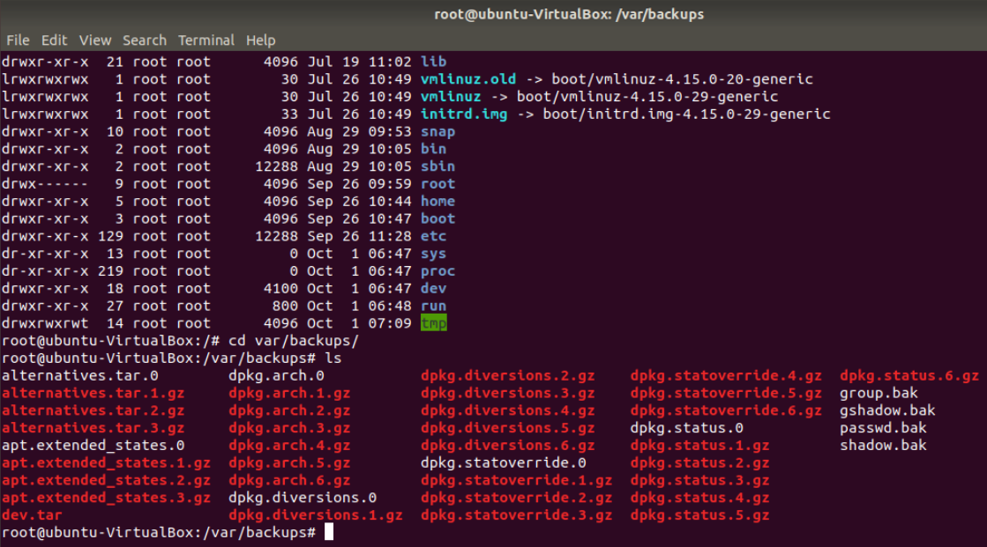

Slide 26
The End
Thank You!!!

